Slide 1

Algoritma Pemrograman Dasar :
Javascript
4
Day 5

Slide 2
1
Array
Outline Class
2
Object

Slide 3

Array
What is an Array?
An array is a special variable, which can hold more than one value at a time.
If you have a list of items (a list of car names, for example), storing the cars in single variables could look like this:
let car1 = "Saab";
let car2 = "Volvo";
let car3 = "BMW";
However, what if you want to loop through the cars and find a specific one? And what if you had not 3 cars, but 300?
The solution is an array!
An array can hold many values under a single name, and you can access the values by referring to an index number.

Slide 4
Array Method
push() – Insert an element at the end of the array.
unshift() – Insert an element at the beginning of the array.
pop() – Remove an element from the end of the array.
shift() – Remove an element from the beginning of the array.
Array.isArray() – Determine if a value is an array.
length – Determine the size of an array.

Slide 5
Array Iteration
map() – Creates a new array by performing a function on each array element.
filter() – Creates a new array with all the elements that satisfies the condition mentioned in the function.
some() – Method returns a boolean value (true/false) based on at least one element in the array passing the condition in the function.
every() – Method detects if every element of the array satisfies the condition passed in the function.

Slide 6

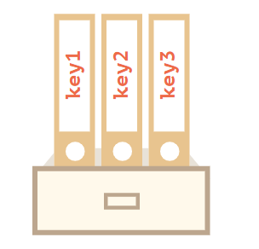
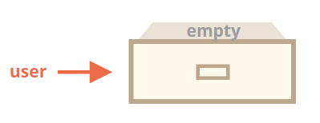
Objects
An object can be created with figure brackets {…} with an optional list of properties.
A property is a “key: value” pair, where key is a string (also called a “property name”), and value can be anything.
We can imagine an object as a cabinet with signed files.
Every piece of data is stored in its file by the key. It’s easy to find a file by its name or add/remove a file.

Slide 7
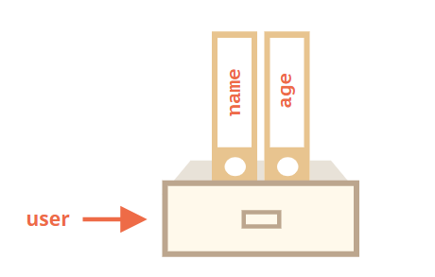
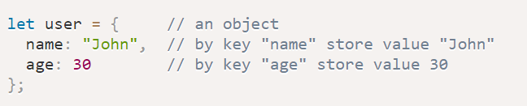
Literals and Properties
We can immediately put some properties into {...} as “key: value” pairs:

Slide 8
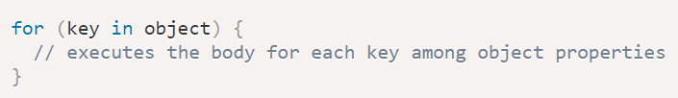
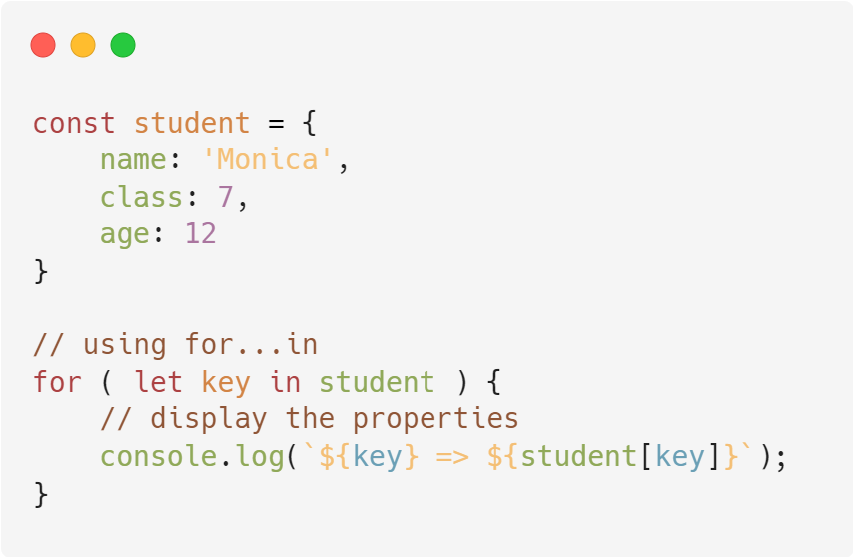
The “For...in” loop
To walk over all keys of an object, there exists a special form of the loop: for..in.

Slide 9
Thank you

